Slide 1
Network Analysis for Political and Social Science Research
Tim Marple
Guest Lecture
PolSci239T: Computational Methods
October 30 ^{th}, 2019
Notes:
Hello and welcome!

Slide 2
What’s a Network Anyway?
‘Our observations are not independent!’
Battle cry of the Political Networks APSA group
Many (most) social phenomena are relational
Involve interactions among actors, entities
Often, the structure of these interactions matter
Network analysis allows for systematic analysis of these

Slide 3
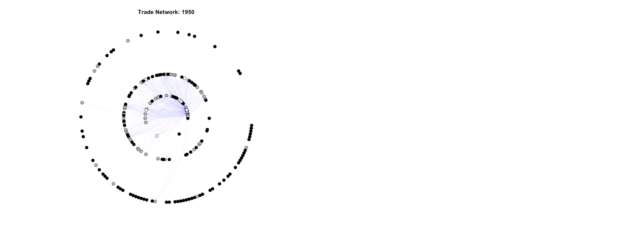
Example: Trade and Banking
Rethinking economic conceptions of surplus flows

Slide 4
Example: Our Department!

Slide 5
How Do I Do This Magic?
Understand structural logic of networks
Get yourself some (appropriate) network data
Use some fancy R packages to compile the network
Leverage network statistics for inference

Slide 6
Building Blocks: Nodes & Edges
Node: anything that has relationships with other nodes
People, firms, organizations, states, countries, etc.
Edge: a relationship between any two nodes
Friendship, investment, membership, wars, trade, etc.
Network = Nodes + Edges

Slide 7
Types of Nodes, Edges, Networks
Nodes can be:
All of one type (one-mode) or two (bimodal)
Edges can be:
All of one type (standard) or two+ (multiplex)
Undirected (mutual) or directed (potentially one-sided)
Binary or weighted (varying in degree of magnitude)
Networks: complete, ego-networks, temporal, …

Slide 8
Building Social Networks
Networks require prior definition to make any sense:
What counts as a node? An edge?
Theoretically infinite configurations
What you specify = what you map
Specification should be bounded and complete
Clear definition of what a node, edge is (and is not)
Under that definition, complete observations on that space

Slide 9
Measurements in Networks
Complete data matter for network measures:
Node-level:
Degree = number of edges a node has (directed or not)
Eigenvector centrality, betweenness, constraint, etc.
Network-level:
Density, diameter, average path length
Centralization, transitivity, communities, etc.

Slide 10
We’re Not Done Yet!
All good learning is interactive, so…
~LET’S NETWORK~

